Slide 1

Search Engine Optimization
Risala Tasin Khan
Professor
IIT, JU

Slide 2
Overview
Search Engines
A search engine is a service where internet users can go to the search engine web site and search for web sites that interest them by inputting keywords. The search engine then displays the results of their search starting with the web sites that best meet the search criteria down to the web sites that least fit the search criteria.
Search engines are becoming ever more popular especially when you consider how many web sites there are on the internet today and most users have limited time to find what they are looking for.
Search engine optimization is the process of getting your web site address or URL as close as possible to the top of the search results when someone using the search engines is looking for the products you sell.

Slide 3

Cont…
Search engine optimization (SEO) refers to techniques that help your website rank higher in organic (or “natural”) search results, thus making your website more visible to people who are looking for your product or service via search engines.
1
SEO is part of the broader topic of Search Engine Marketing (SEM), a term used to describe all marketing strategies for search.
2
SEM entails both organic and paid search.
3
With paid search, you can pay to list your website on a search engine so that your website shows up when someone types in a specific keyword or phrase.
4
Organic and paid listings both appear on the search engine, but they are displayed in different locations on the page.
5

Slide 4
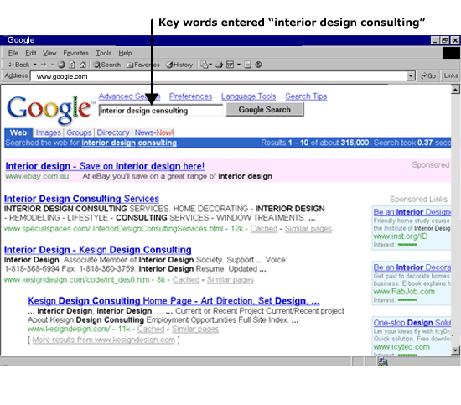
Search Engine Optimisation
Search Engines

Slide 5



How to improve Google organic ranking?
What Is SEO & Why Is It Important?
SEO Known as Search Engine Optimization
SEO is all about understanding what your target audience needs. It helps you display the informative information to the right users from any device to convert the visitor into your persona.
Why SEO is important
SEO in Helping Your Business Grow
Build Better Relationships with your Audience
SEO can increase the quantity and quality of traffic to your website, App, Social media, or any other channel you are using for digital marketing purposes & increase ROI (Return Of Investment).
OUTRANK YOUR COMPETITOR

Slide 6

Why SEO is important
On Google alone, there are over 694,000 searches conducted every second.
Think about that!!!!!!
Every second that your website is not indexed on Google, you are potentially missing out on hundreds, if not thousands of opportunities for someone to visit your website, read your content, and potentially buy your product or service.
Practicing SEO basics, as well as more advanced techniques after those, can drastically improve your website‟s ability to rank in the search engines and get found by your potential customers.

Slide 7

What about paid search
Yes, you can pay to have your website listed on the search engines.
However, running paid search campaigns can be quite costly if you don’t know what you’re doing.
Not to mention, about 88% of search engine users never click on paid search ads anyway.
Because the sole purpose of a search engine is to provide you with relevant and useful information, it is in everyone’s best interest (for the search engine, the searcher, and you) to ensure that your website is listed in the organic search listings.
In fact, it is probably best to stay away from paid search all together until you feel you have a firm grasp on SEO and what it takes to rank organically.

Slide 8
Search Engine Basics
Search Engines
Good placement in search engines results from a combination of preparation and opportunity .
Search engines claim you can get results in as few as 24 hours, yet it can often take 2 months before most search engines cycle through their backlog of new entries.
With 90% of the sites indexed in search engines being junk, getting good exposure via search engines is difficult.

Slide 9
How Search Engine Works
Search engines have one objective – to provide you with the most relevant results possible in relation to your search query.
If the search engine is successful in providing you with information that meets your needs, then you are a happy searcher.
And happy searchers are more likely to come back to the same search engine time and time again because they are getting the results they need.
In order for a search engine to be able to display results when a user types in a query, they need to have an archive of available information to choose from.
Every search engine has proprietary methods for gathering and prioritizing website content.
Regardless of the specific tactics or methods used, this process is called indexing.
Search engines actually attempt to scan the entire online universe and index all the information so they can show it to you when you enter a search query.

Slide 10
How They do Indexing
Every search engine has what are referred to as bots, or crawlers, that constantly scan the web, indexing websites for content and following links on each webpage to other webpages.
If your website has not been indexed, it is impossible for your website to appear in the search results.
So, big search engines like Google, Bing, and Yahoo are constantly indexing hundreds of millions, if not billions, of webpages

Slide 11
How do Search Engine Knows what to Show
The search engines consider two main areas when determining what your website is about and how to prioritize it.
1. Content on your website:
When indexing pages, the search engine bots scan each page of your website, looking for clues about what topics your website covers and scanning your website’s back-end code for certain tags, descriptions, and instructions.
2. Who’s linking to you:
As the search engine bots scan webpages for indexing, they also look for links from other websites.
The more inbound links a website has, the more influence or authority it has.
Essentially, every inbound link counts as a vote for that website’s content. Also, each inbound link holds different weight.
For instance, a link from a highly authoritative website like The New York Times (nytimes.com) will give a website a bigger boost than a link from a small blog site. This boost is sometimes referred to as link juice.

Slide 12
Cont…
When a search query is entered, the search engine looks in its index for the most relevant information and displays the results on the Search Engine Result Page (SERP).
The results are then listed in order of most relevant and authoritative.
If you conduct the same search on different search engines, chances are you will see different results on the SERP.
This is because each search engine uses a proprietary algorithm that considers multiple factors in order to determine what results to show in the SERP when a search query is entered.

Slide 13
Cont..
A few factors that a search engine algorithm may consider when deciding what information to show in the SERP include:
Geographic location of the searcher
Historical performance of a listing (clicks, bounce rates, etc.)
Link quality
Relevance
Human value
Authority and trust
Webpage content (keywords, tags, pictures)
Link type (social media sharing, link from media outlet, blog, etc.)

Slide 14
Search Engine Tips
Search Engines
Submit Web site to search engine (http://google.com/addurl).
Use keywords in the content near the top of the document.
Keywords placed inside clickable link text ranks higher.
Use descriptive Web page titles.
Use a descriptive URL, for example: www.webmastercertification.com/webmaster-courses.cfm.
Encourage other sites to link to yours.

Slide 15
Search Engine Tips
Search Engines
Purchase alternate Web names, point them all to your Web site, then submit those names.
Use Meta Tags correctly
Visiting your own link in the results of some search engines can improve your ranking.
Avoid keyword spamming, any excessive use of keywords can hurt your placement in the search engines.

Slide 16
Search Engine Urban Legends
Search Engines
The list below contains factors that are presumed to improve search engine placement but typically do not.
Using popular search terms unrelated to your content does yield more traffic but not quality traffic.
Search engines are not case sensitive. Searching on "webmaster" or "Webmaster" will yield the same results.
The order that keywords are typed into a search engine does not affect the results.
Meta Tags are presumed to be the key to high rankings; however with many search engines, they are primarily used to determine what words to index a site with, and not as much how high to rank it.

Slide 17
What it Takes to Rank
It is not difficult to get your website to index and even rank on the search engines.
However, getting your website to rank for specific keywords can be tricky.
There are essentially 5 elements that a search engine considers when determining where to list a website on the SERP:
Publish Relevant Content
Update your content regularly
Metadata
Have a link-worthy site
Authority

Slide 18
1. Publish Relevant Content
Quality content is the number one driver of your search engine rankings and there is no substitute for great content. Quality content created specifically for your intended user increases site traffic, which improves your site's authority and relevance.
Keywords
Identify and target a specific keyword phrase for each page on your website.
Think about how your reader might search for that specific page with search terms like:
masters in engineering management
what is biomedical engineering?
Multiple Keyword Phrases
It is very difficult for a webpage to achieve search engine rankings for multiple keyword phrases—unless those phrases are very similar.
A single page may be able to rank for both "biomedical engineering jobs" and "biomedical engineering careers".
But ranking for "student affairs" and "dean of students" or "gender discrimination" and "violence reporting procedures" with a single page is unlikely.
If you want to rank for multiple keywords phrases with your website, you will need to make a separate webpage for each keyword phrase you are targeting.

Slide 19
Cont…
Placing Keywords
Once your keyword phrase is chosen for a given page, consider these questions:
Can I use part or all of the keyword phrase in the page URL (by using keywords in folders)?
Can I use part or all of the keyword phrase in the page title?
Can I use part or all of the keyword phrase in page headings and subheadings?
Answering yes to these questions can improve your search engine ranking.
Be natural and user-friendly, though.
For instance, you do not want the word "engineering" to show up three or more times in the URL or have the phrase Northern Lights repeated in the page title and every heading.
Readability and usability still trump search engine optimization.

Slide 20
Cont…
Content
Beyond page URL, title, and headings, content is most influential on search engine rankings.
Repeat your keyword phrase several times throughout the page—once or twice in the opening and closing paragraphs, and two to four more times throughout the remaining content.
Don't forget to use bold, italics, heading tags (especially an H1), and other emphasis tags to highlight these keyword phrases—but don't overdo it.
You still want your language and writing style to read naturally.
Never sacrifice good writing for SEO.
The best pages are written for the user, not for the search engine.

Slide 21
2. Update Your Content Regularly
You've probably noticed that we feel pretty strongly about content.
Search engines do, too.
Regularly updated content is viewed as one of the best indicators of a site's relevancy, so be sure to keep it fresh.
Audit your content on a set schedule (semesterly for example) and make updates as needed.
Relevance is a one of the most critical factors of SEO.
The search engines are not only looking to see that you are using certain keywords, but they are also looking for clues to determine how relevant your content is to a specific search query.
Besides actual text on your webpages, the search engines will review your website’s structure, use of keywords in your URLs, page formatting (such as bolded text), and what keywords are in the headline of the webpage versus those in the body text.

Slide 22
3. Metadata
When designing your website, each page contains a space between the <head> tags to insert metadata, or information about the contents of your page.
It is important for you to review and update Metadata as your site changes over time.
Title Metadata
Title metadata is responsible for the page titles displayed at the top of a browser window and as the headline within search engine results.
It is the most important metadata on your page.

Slide 23
Cont…
Description Metadata
Description metadata is the textual description that a browser may use in your page search return.
Think of it as your site's window display—a concise and appealing description of what is contained within, with the goal of encouraging people to enter.
A good meta description will typically contain two full sentences.
Search engines may not always use your meta description, but it is important to give them the option.

Slide 24
4.Have a link-worthy site
Focus on creating relevant links within the text. Instead of having "click here" links, try writing out the name of the destination.
"Click here" has no search engine value beyond the attached URL, whereas “Michigan Tech Enterprise Program” is rich with keywords and will improve your search engine rankings as well as the ranking of the page you are linking to.
Always use descriptive links by linking keywords—it not only improves search engine optimization, but also adds value to your readers, including those with disabilities or who are using screen readers.
Always describe your visual and video media using alt tags, or alternative text descriptions.
They allow search engines to locate your page, which is crucial—especially for those who use text-only browsers or screen readers.

Slide 25
5.Authority
Search engines determine how authoritative and credible a website’s content is by calculating how many inbound links (links from other websites) it has.
However, the number of inbound links does not necessarily correlate with higher rankings.
The search engines also look at how authoritative the websites that link to you are, what anchor text is used to link to your website, and other factors such as the age of your domain.
You can track over time how authoritative your website is by monitoring a few different metrics.
There are a variety of tools to help you keep track.

Slide 26
Long-Tail Concept & Theory
In order to get your website’s content to rank on the search engines, you need to take the path of least resistance.
Although trying to rank for highly trafficked keywords and terms may seem like a logical approach, it will most likely lead to a lot of frustration and wasted resources.
Also, even if you end up getting traffic from these types of keywords, chances are the quality of the traffic will be low due to disinterest in what you specifically have to offer.
There are billions more unique search queries than there are generic ones.
In fact, if you were to add up all search engine traffic that comes from the most popular keywords, it would not even come close to the amount of traffic that comes from searches using those more unique queries. This is called the theory of the long-tail.

Slide 27
Cont..
A critical component of SEO is choosing the right keywords for optimization.
If you sell shoes, you may want your website to rank for “shoe store,” (a head term), but chances are you are going to have some trouble there.
However, if you optimize multiple pages on your website for each specific pair of shoes that you sell, you are going to have much more success and it will be easier to rank on the SERP.
A keyword like “red tennis shoes with Velcro” (a long-tail keyword or term) is a good example.
Sure, the number of people that search for this keyword will be much lower than the number that search for “shoe store,” but you can almost bet that those searchers are much farther down the sales funnel and may be ready to buy.
This is why long-tail keywords are so effective.
They target people who are looking to perform a specific action, like buy something, or looking for a specific piece of information, like a how-to or a service that can solve their problem.

Slide 28
Content is King
Without rich content, you will find it difficult to rank for specific keywords and drive traffic to your website.
Additionally, if your content does not provide value or engage users, you will be far less likely to drive leads and customers.
It is impossible to predict how people will search for content and exactly what keywords they are going to use.
The only way to combat this is to generate content and lots of it.
The more content and webpages you publish, the more chances you have at ranking on the search engines.
Lottery tickets are a good analogy here. The more lottery tickets you have, the higher the odds are that you will win. Imagine that every webpage you create is a lottery ticket. The more webpages you have, the higher your chances are of ranking in the search engines.

Slide 29
Cont…
As you already know, the search engines are smart.
If you create multiple webpages about the same exact topic, you are wasting your time.
You need to create lots of content that covers lots of topics.
There are multiple ways you can use content to expand your online presence and increase your chances of ranking without being repetitive.
Here are few examples:
Homepage: Use your homepage to cover your overall value proposition and high-level messaging. If there was ever a place to optimize for more generic keywords, it is your homepage.
Product/Service Pages: If you offer products and/or services, create a unique webpage for each one of them.
Resource Center: Provide a webpage that offers links to other places on your website that cover education, advice, and tips.
Blog: Blogging is an incredible way to stay current and fresh while making it easy to generate tons of content. Blogging on a regular basis (once per week is ideal) can have a dramatic impact on SEO because every blog post is a new webpage.

Slide 30
Website Content
There are multiple elements on your website that you can control to make it easy for the search engines to index your content and understand what it is all about.
You want to write content that your audience will find valuable and engaging.
Aside from the topical nature of the content, the way you format your webpages can have an impact on how the search engine bots digest your content.
Every webpage you create should have a thought-provoking headline to grab the reader’s attention, and should also include the keyword or phrase that the webpage covers.
Other body formatting, such as bolding certain keywords or phrases, can help stress the importance of phrases you are optimizing for

Slide 31
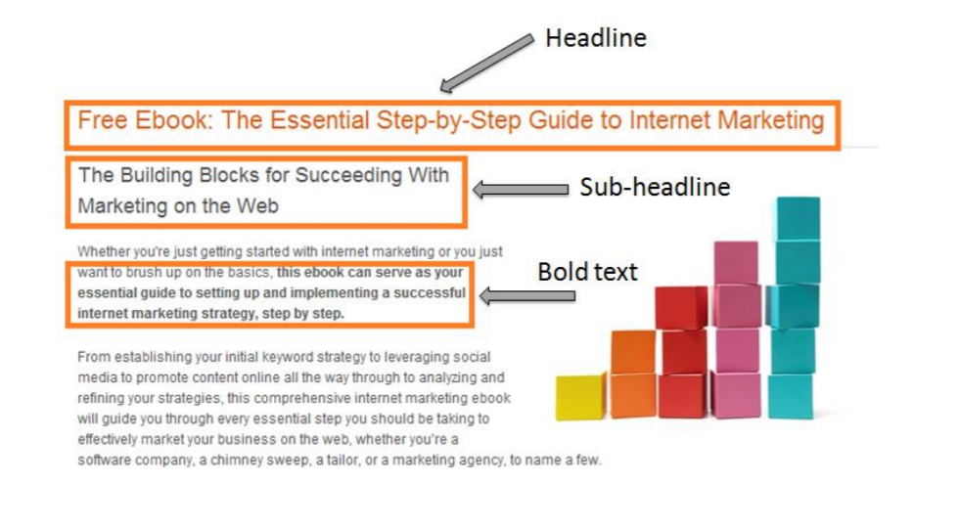

Slide 32
Pictures
There is nothing worse than landing on a webpage and being faced with mountains of text.
Not only are pictures a great way to break up sections of text, but they also serve as an opportunity to communicate with the search engines.
Because search engines cannot tell what a picture is by scanning it, they look for clues in two places.
Every picture you upload to your website will have a file name. When the picture is inserted on your website, the picture’s file name actually lives in your website’s sources code, or HTML.
Since the search engines scan your website’s code, you should use file names that describe the picture.
For example, “red-tennis-shoesvelcro.jpg‟ is much more useful than “pic12345.jpg‟.

Slide 33
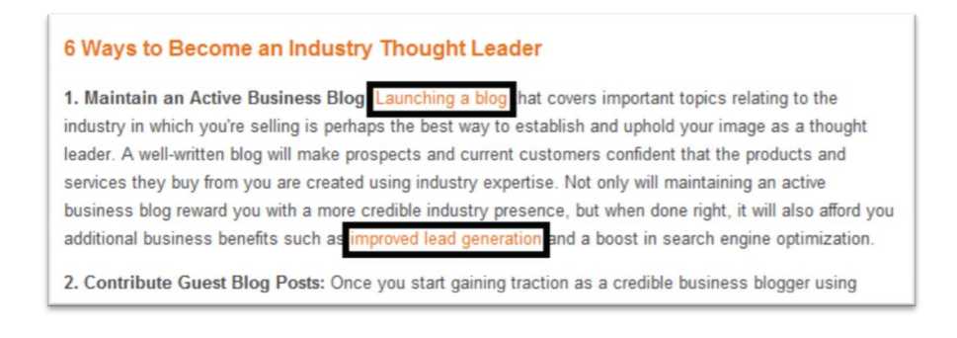
Internal Linking
When creating content for your website on your blog or on specific webpages, you may want to reference other pages on your website.
You can reference these other pages by inserting a link to another webpage within a specific webpage’s content.
The use of anchor text is recommended when linking to another webpage or even another website.
When anchor text is used, it implies that the page you are linking to is about the keyword or phrase you use as your anchor.
This is yet another way you can help out the search engines.

Slide 34
Using Social Media to Spread Content
There’s been an ongoing debate about the impact of social signals on a website’s search rankings.
The main argument being that social media doesn’t directly affect your SEO.
However, it does have an impact on the factors that do affect rankings such as traffic, meaning it indirectly affects your rankings.
Studies by HootSuite have suggested that there’s a correlation between social media shares and higher rankings.
You might have noticed that yourself: content that ranks well on Google often also has a lot of shares, retweets, and likes.

Slide 35
Cont…
Why do posts that get shared a lot also tend to be posts that rank more highly?
While social media shares might be correlated with better rankings, that doesn’t mean that the social media shares cause better rankings.
A piece of your content could get shared thousands of times on Twitter without necessarily budging at all in Google’s search engine results.
Instead, when social media appears to be causing a boost in ranking, this is what’s happening:
Content that gets shared a lot gets seen a lot.
Content that gets seen a lot is more likely to get linked to from other websites.
Those additional backlinks are the cause of the better rankings.
The improved rankings also lead to increased social media activity.

Slide 36
Cont..
Beyond using social networks to engage new prospects, drive leads, and build brand awareness, businesses should consider all of the SEO benefits they miss out on by not having a brand presence.
In order to capitalize on the boost to your SERP rankings from social media, you need to make your content easy to share.
Implementing social network buttons across your website is the easiest way to accomplish this.

Slide 37
What is Hidden Text
Hidden text (Cloaking) means the text not visible to users but shown to search engines. Users can not see the content at all.
Cloaking is a search engine optimization technique in which the content or information presented to the user is different from that presented to search engine crawlers (i.e. spiders or bots) for better indexing.
In other words, the web server is specially programmed to return different content to search engines than it returns to regular users, in an attempt to distort search engine rankings.
For example:
Invisible or Hidden text
Using this approach, webmasters add additional information like keywords stuffing, overwriting content in a way that is invisible or hidden to the users. To do this, webmaster add this information in the same color that of background color which is not visible to human eyes.

Slide 38
Why Hidden Content Alternative is Used
Back in the day, when search engines were much less sophisticated, you could hide text on webpages in an attempt to gain ranking for certain keywords not visible on the page.
You could also hide links on other websites linking back to the page you wanted to gain ranking.
Why the need of this???
Keyword Spamming the Page
Some SEO professionals believe that increasing the keyword count on a page can help rank that keyword. This may have been an effective strategy in the ancient SEO ages (late ’90s to early 2000s) but not today.
Hiding Links
Links are still strong ranking factors. Many sites used to get links from other sites that were hidden. These links were hidden because often times they were unrelated to the content on the site where they were posted.
Sometimes, the links are added on the sites that are owned by the same company, or owned by a partner that has predefined this relationship. Other times, sites are hacked to be able to add the links; this is not only bad for SEO, but is also illegal.

Slide 39
Valid Reasons for Hidden text
Consider a page showing a product with a very long description, specifications, 100s of user reviews, seller information, pricing chart and much more.
If such a page is loaded, it will be a very big browser window.
Users will need to scroll a lot to see the contents on that page.
But people hate scrolling.
Instead the page can have tabs for each section on the page. Users can easily expand each tab by clicking on it and see the content without much scrolling.

Slide 40
Cont…
Paid Content Subscription
Google allows websites that offer paid subscription to hide content and even honors the First Click Free method of cloaking.
This means that upon the initial visit from Google, you will see the content; but on the second visit to the page, the content no longer appears, instead you will need to login and often pay to view the content.
The intent here is to just give a sample preview of what a paid subscription of a publisher has to offer.

Slide 41
Cont…
Graceful Degradation
Some developers prepare their sites for the optimal user experience with advance web browsers and old web browsers.
They ensure that – if the browser doesn’t support images, JavaScript, or CSS – this content will still render properly.
However, to enable this capability, sometimes the content for the old web browsers need to be hidden on the new web browsers.
This also applies to cases in which these features are disabled on a browser and when the page can’t load simply due to bandwidth constraints.
Search engines may see both pieces of content but as long as the content that appears on a degraded view is exactly the same as the content on the normal view, there shouldn’t be a problem.

Slide 42
Consequences of hidden text & links
If Google finds hidden text and links on your website, it may get penalized. You may lose its rankings for a long time, even after the text is removed. Once a website gets penalized, it is very difficult to gain that trust and reputation again.
Google always tries to provide clean, high quality and informative search results. Only that’s why users trust Google. If websites are ranked on the basis of hidden keywords, users may stop trusting Google. Or may be, they can never use Google again.

Slide 43
Link farms
Link farms are groups of Web sites that link to one another, thereby boosting their ranking in search engines that use a PageRank algorithm to judge the “usefulness” of a site.
Search engines require ways to confirm page relevancy.
A known method is to examine for one-way links coming directly from relevant websites.
The process of building links should not be confused with being listed on link farms, as the latter requires reciprocal return links, which often renders the overall backlink advantage useless.
For instance, in the 2010 holiday season, JCPenney was found to be the highest ranked merchant for a large number of clothing products.
On examination, it was discovered that this resulted from Penney’s hiring a search engine optimization company to create thousands of Web sites that linked to JCPenney’s Web site.
As a result, JCPenney’s Web site became the most popular (most linked-to) Web site for products like dresses, shirts, and pants.
No matter what popular clothing item people searched for, JCPenney came out on top. Experts believe this was the largest search engine fraud in history

Slide 44
Content farms
Content farms are companies that generate large volumes of textual content for multiple Web sites designed to attract viewers and search engines.
Content farms profit by attracting large numbers of readers to their sites and exposing them to ads.
The content typically is not original but is artfully copied or summarized from legitimate content sites.

Slide 45
Click fraud
Click fraud occurs when a competitor clicks on search engine results and ads, forcing the advertiser to pay for the click even though the click is not legitimate.
Competitors can hire offshore firms to perform fraudulent clicks or hire botnets to automate the process.
Click fraud can quickly run up a large bill for merchants, and not result in any growth in sales.

Slide 46
Doorway pages
Search Engines
Doorway page is a keyword stuffed page which after a few minutes redirects to another page, the real page webmaster wants to show. This page is generally Affiliate page .
So using doorway pages, both Google and human see the same page. They are bad for users because they can lead to multiple similar pages in user search results, where each result ends up taking the user to essentially the same destination.
They can also lead users to intermediate pages that are not as useful as the final destination.
Webmasters that use doorway pages would generally prefer that users never actually see these pages and instead be delivered to a "real" page within their sites.
To achieve this goal, redirection is sometimes used. This may be as simple as installing a meta refresh tag on the doorway pages.

Slide 47
Search Engine Popularity
Search Engines
You have integrated your keyword terms into your Web pages using the techniques previously discussed. But this only prepares your pages for what the search engines like to see.
The goal now is to convince the search engines that the visitors to your site are satisfied as well.
Many of today's search engines incorporate methods to track the popularity of links in the search results returned. The more popular a link is, the higher in the rankings the site will appear.

Slide 48
Link Popularity (off page)
Search Engines
The first method search engines use to grade a Web site is how many Web sites point to them.
Hence if your site has 100 other sites linking to you, but your competitor has only 10, your site will rank higher in some search engines. As a byproduct, every site that links to you is a potential entry point for your customers.
There are many options to getting linked, most of which are byproducts of other E-Marketing techniques. Some examples include business directory sites, Web awards, Internet top 50 sites, resource sites, banner sites, blind links, affiliate links, free Web sites and reciprocal links with other non-competing Web sites.
Once you are linked by any of these methods, it is advantageous to submit the sites that point to you to the search engines as many of them may not be indexed. This not only tells the search engines that they exist but also that they link to you.

Slide 49
Link Popularity
Search Engines
Blind Links
Blind links are links in a Web page that are not visible to the visitor, but visible to the search engines.
It is possible to put these links in other pages that you create and point them all back to your main site.
This can be accomplished by making very small 1x1 graphics that display the same color as the background of the page. Simply name the graphic(s) something meaningful like "webmastertraining.gif" and point the link to the corresponding Web site.
Affiliate Links
Affiliate links are links to your site where the site containing the link to your site earns money either by people visiting your site or by producing sales. For example, WebmasterCertification.com has an affiliate program that pays 5% of all course sales that come from the affiliate site. As a byproduct, the affiliate sites are linked to you and can be submitted to search engines to improve your popularity.
.

Slide 50
Click Popularity
Search Engines
Click popularity is a measure of how often your link in search results is clicked.
In some search engines, the more often your link is clicked, the higher your site ranks in the search results.
Thus, in popularity-driven search engines, you can search on your keyword terms, then go through the search results clicking on every link within the results that links to your site. Over time this will improve your position in these search engines.
The more savvy search engines keep track of how much time you spent at a given link, this is referred to as popularity stickiness.
If you click on the first link in the search results, then back up and choose another link immediately, the search engine assumes you did not like the first result very much.
A good strategy for you is to set your browser's home page to the search engine you would like to target, and each time you open your browser you search on your keywords, click on your link, then leave that search engine alone for a while (the exact delay time is unknown).

Slide 51
Click Popularity
Search Engines
Focus on multiple search terms
One of the biggest oversights in the search engine placement wars is focusing all your energy on one really good search term.
You need to target multiple keyword terms, ones that have proven to be good search terms relative to the people doing the searching.
Visiting Competitors Sites
It is often valuable to visit the competition's Web site.
Remember that if you click on their links, you are improving their popularity as well. Instead, manually type the URL for the competition Web site into your browser location bar. This will get you to their site without giving them click popularity credit.

Slide 52
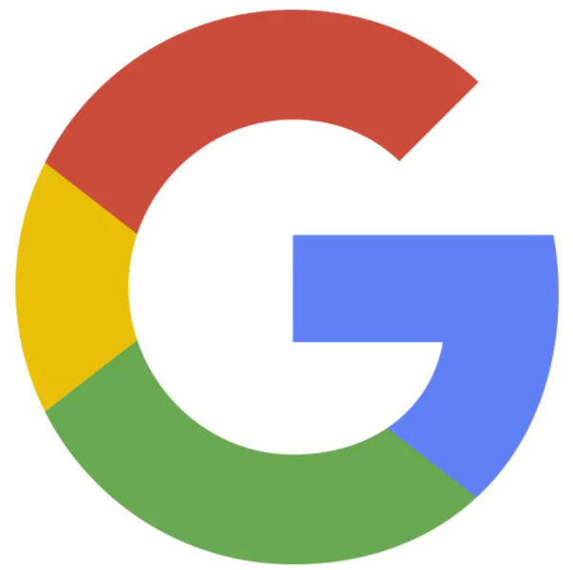
How to improve Google organic ranking?
7 Simple Steps to Rank on Google by Dec 2021
Understanding The
Google Rank Brain
7
1
Competitors Research & Target the audience
2
Create a Super faster website by following Google’s best practices & guidelines
Off-Page SEO
Content Marketing (Link Building)
6
3
Create Comprehensive in-depth content.
Local SEO
5
4
On-Page SEO

Slide 53
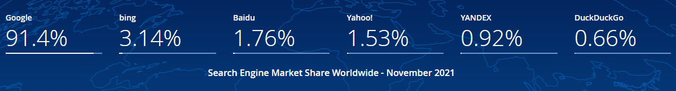
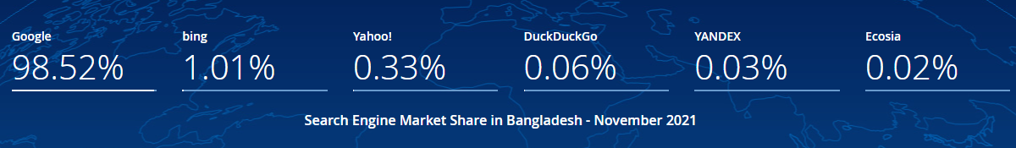
How to improve Google organic ranking?
Let’s look into these statistics before the move to the Google
Search Engine Market Share Worldwide Nov 2021
Search Engine Market Share in Bangladesh November 2021

Slide 54



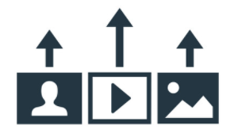
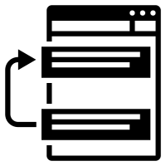




How to improve Google organic ranking?
SEO’s is more than you think
Competitors Research & Target the audience
Create balance between Website Content & Visuals of Website
Increase Customer Conversions to the Website through SEO & Generate Leads from Natural Search
Recommendation for Content Strategy & Development (On-Page, Off-Page Content Marketing, Link building)
To appear in Top 10 rankings in the first page on Google
Build sustainable long term natural search rankings
Keywords Generator for the Website & Top Keywords association in Search Engines
Competitor SEO analysis (Top 10 Competitor for your Industry) and SEO Analysis of Top Local Companies

Slide 55
How to improve Google organic ranking?
Don’t forget about the Seven simple steps.
1
Competitors Research & Target the audience
Create Super faster website
Create killer content (Comprehensive in-depth)
On-Page SEO
Local SEO
Off-Page SEO Content Marketing (Link Building)
Understanding The Google Rank Brain
3
2
3
70M post every months
by WordPress users alone
4
99% Post Never
rank on Google
5
6
Q1 of 2021 600 million blogs on the internet
7

Slide 56
On Page SEO
On-page SEO (also called on-site SEO) is the practice of optimizing web pages to rank higher in search engines. It includes optimizations to visible content and the HTML source code.
Google looks at your page’s content to determine whether it’s a relevant result for the search query. Part of this process involves looking for keywords.
The most basic concept that the information is relevant is when a webpage contains the same keywords as the search query.
If those keywords appear on the page or if they appear in the heading or body of the text, the information is more likely to be relevant.
Google is ultimately looking for the most relevant search result for a query, so their algorithms also look for other relevant content on the page.
If your page is about dogs and you don’t mention different breeds or other relevant contents about dogs, Google knows there are probably more relevant results on other pages instead of your page and unlikely to rank you.
Relevance is such a big part of on-page SEO that unless you crack it, you’re unlikely to rank.
Before you even think about making ‘technical’ optimizations like placing keywords here or there, you need to create content that Google wants to rank.

Slide 57
Local SEO
Local SEO is a search engine optimization (SEO) strategy that helps your business be more visible in local search results on Google.
Any business that has a physical location or serves a geographic area can benefit from local SEO.
After analyzing the behavior of users during trillions of searches, Google figured out that people seeking certain types of businesses need results from their immediate area.
That’s why Google’s local search algorithm includes a proximity factor, which is a fancy way of saying that Google takes your location into account when you search for a local keyword (a query with local intent). This happens even when the searcher doesn’t include a city name or "near me” in their search
If you’re at work and want to get a pizza delivered for lunch, for example, Googling “pizza delivery” shows a list of locations near your office in its local SERPS (search engine result pages).

Slide 58
OFF-Page SEO
Off-page SEO simply tells Google what others think about your site.
For example, if you’ve got a lot of valuable links pointing to your pages, search engines will assume that you’ve got great content – the type that provides value for users.
Links are still very important to Google. In fact, it’s almost impossible for Google to determine the value of any web page if there are no links pointing to it — no matter how useful, fresh, or in-depth the page content might be.
An internal link connects one page of a website to a different page on the same website. In an internal link, the source domain and target domain are the same.
Internal linking has three main purposes:
Aids in website navigation
Defines the architecture and hierarchy of a website
Distributes page authority and ranking power throughout the site

Slide 59

How to improve Google organic ranking?
Competitors Research & Target the audience
Find your competitors. If you are a fresher, try using the Alexa site info, for free.
Find your competitor keywords. If you don’t know how: Use SEMRUSH to Create a free account.
Prepare your list of keywords.
Check competitors Backlinks, if you don’t know how: Use Ahref’s (Google enough for free analyzing)
Prepare your content marketing plan (For referral traffic and Link Building)
Pay Close Attention to competitors Top Ranking Pages & Keywords using a Free SEMRUSH Account.
Use only those keywords that match your business goals.
Find keyword gaps and opportunities using SEMRUSH or ALEXA site info to target new users.
Analyze, Measure, Optimize & Monitor again and again
OUTRANK YOUR COMPETITOR

Slide 60

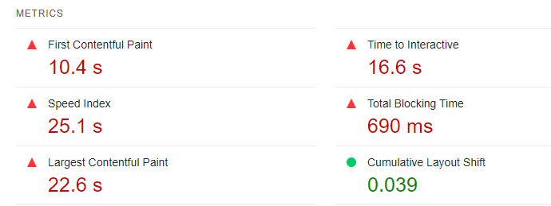
How to improve Google organic ranking?
Create Super faster website
buet.ac.bd/web/ (Just an example site)
4
Minimize HTTP requests
Minify and combine files
Use asynchronous loading for CSS & JS files
Defer JavaScript loading
Minimize time to first byte
Reduce server response time
Run a compression audit
Enable compression & browser caching
Reduce image sizes & external scripts
Monitor your speed (mobile page) over time
OUTRANK YOUR COMPETITOR
BUET Website Speed Test as of 12th Dec 2021

Slide 61
How to improve Google organic ranking?
Create killer content (Comprehensive in-depth)
Always Know and Understand the Audience You Address
Be Relevant, Concise, and Easily Digestible
Have a Clear Objective
Develop and Perfect Your Unique Voice
Craft Great Headlines
Pay Close Attention to Editing and Proofreading
Engage with your Readers
Align Your Content’s Message with Your Marketing and Sales Message
Analyze, Measure, Optimize again and again
Identify Problem
Prepare Layouts
Share Story
Don’t Forget to Analyze Your Competitors

Slide 62
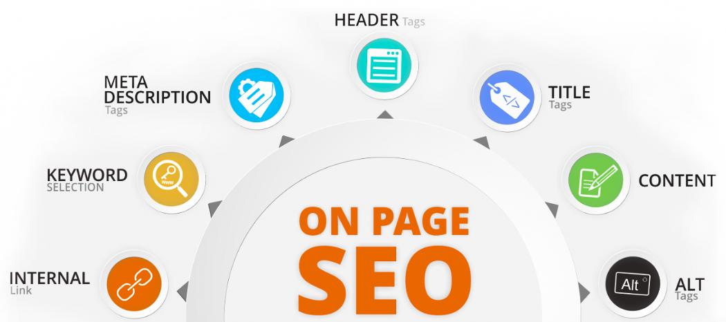
How to improve Google organic ranking?
On-Page SEO
THE MOST POWERFUL ELEMENT ON THE SERPs
OUTRANK YOUR COMPETITOR

Slide 63
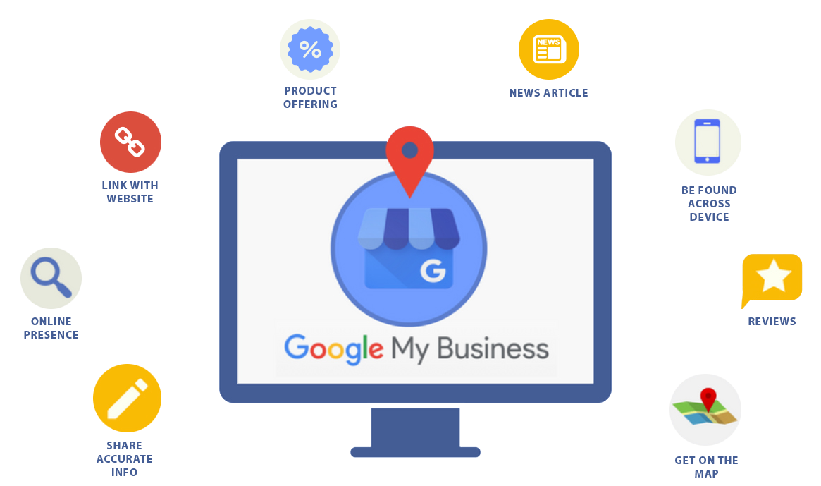
How to improve Google organic ranking?
Local SEO
Trustworthy
Awareness
Consideration
Conversion
Loyalty
OUTRANK YOUR COMPETITOR
Now known as Google Business Profile.

Slide 64
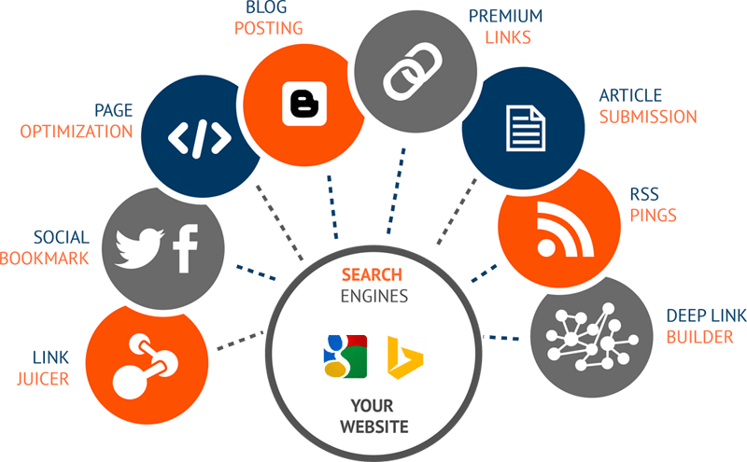
How to improve Google organic ranking?
Off-Page SEO Content Marketing (Link Building)
Playing vital role on the ranking.
- Rich Site Summary
OUTRANK YOUR COMPETITOR
99% SEO PROFESIONAL FAILED HERE

Slide 65
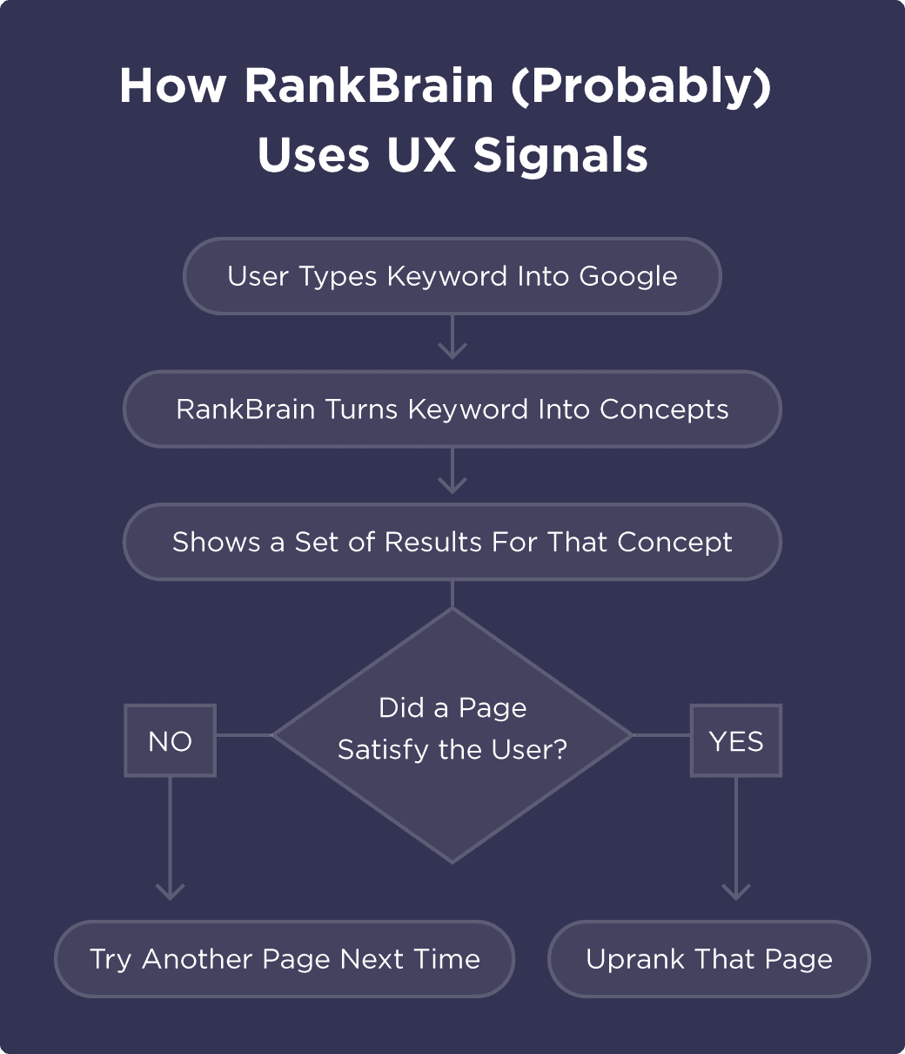
How to improve Google organic ranking?
Understanding The Google
RankBrain
Check your keyword position on the Google Search Console
Check your page performance on the Google Analytics
Check Bounce Rates and Use Google Tag Manager to analyze further
Improve session time on the landing page
Reduce bounce rates
Improve engage rates
Improve your content based on search query on the Search Console
Continue on-page optimization
Continue off-page optimization
Monitor your page for targeted keywords
OUTRANK YOUR COMPETITOR

Slide 66
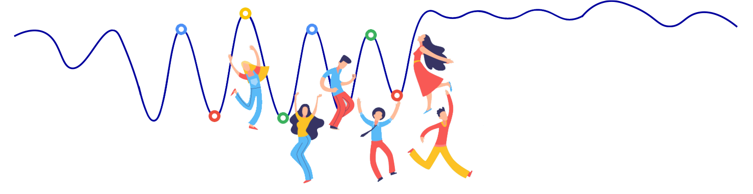
How to improve Google organic ranking?
Are you going to rank now?
YES, IF YOU CONSIDER THE POINT BELOW
OUTRANK YOUR COMPETITOR
Remove Spamming Reduce Irrelevant content and link Improve User Experience
Monitor Competitors Ranking algorithm change Fixing website & server error

